Slide 1
Introduction to Python

Slide 2
Agenda
Jupyter Notebook
Variables
Data Types
Fundamental Data Types
Functions in Python – print()
Operators
Python Flow Control
Pseudocodes

Slide 3
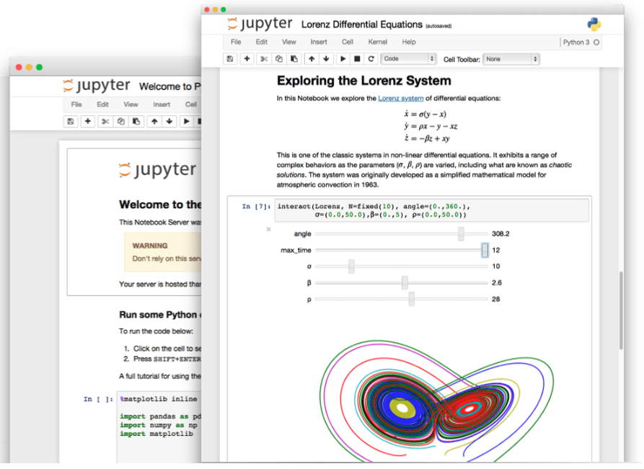
Jupyter Environment
The Jupyter Notebook is an open-source web-based development application that allows you to create documents that can have code, equations, visualizations and narrative text.
Mainly used for data cleaning and Data transformation, statistical modeling, data visualization, machine learning, deep learning and much more.

Slide 4
Jupyter Environment
You can use Jupyter for over 40 programming languages. Within the data science community, mainly used for Python, R, Julia and Scala.
You can also use Jupyter with big data tools, like Apache Spark from Python (known as PySpark), R and Scala. You can explore big data with pandas, scikit-learn, ggplot2, TensorFlow and more.

Slide 5
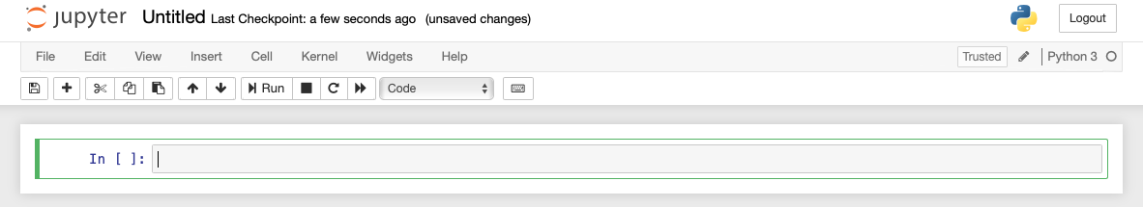
Jupyter Editor
Notebook name. Click here to change the name of the notebook
Menu bar
Toolbar
Code cell. Write your code here

Slide 6
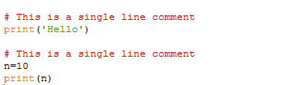

Commenting code
#
Code commenting is required in order to describe the purpose of the code. This is not only a good practice but also a mandatory practice in most organizations.

Slide 7
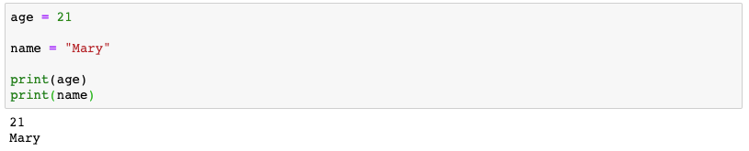
Variables
Variables are containers that store data. Python has no command for declaring variable
You simply assign a value to a variable to create it
You use = to assign a value to a variable

Slide 8
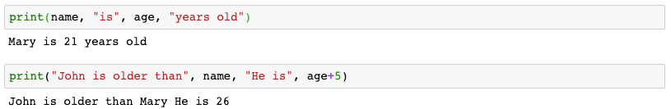
Print variables with texts

Slide 9

Reassign variable

Slide 10
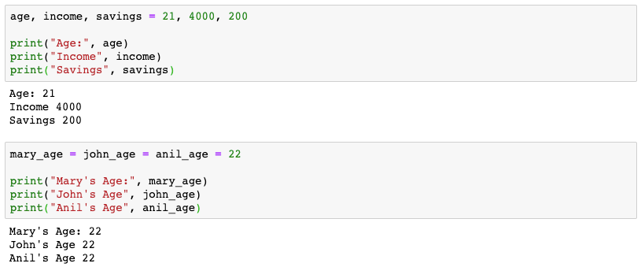
Multiple variables assignment with same value

Slide 11
Multiple variables assignment with different values

Slide 12
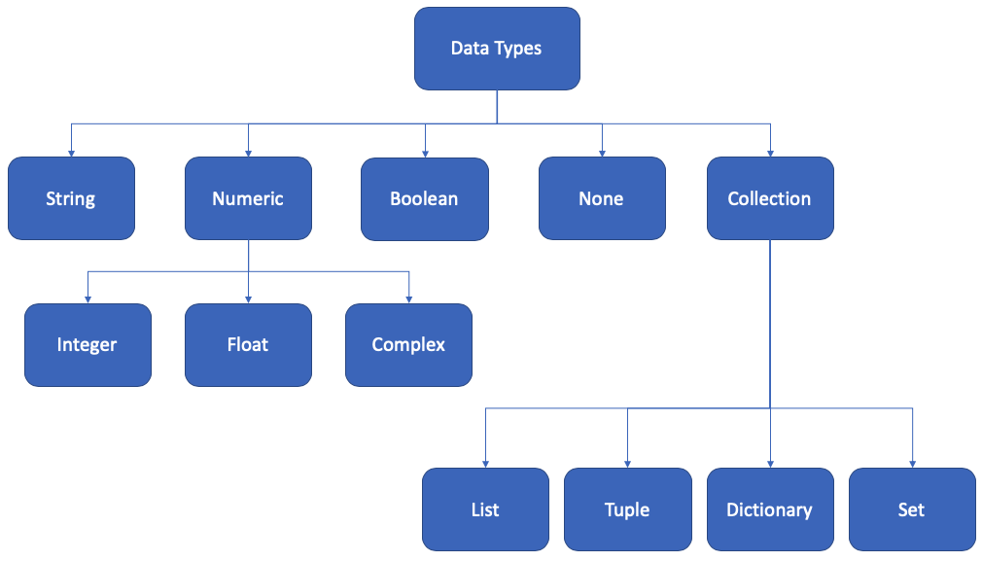
Python data types

Slide 13

We learn the following in our session today

Slide 14
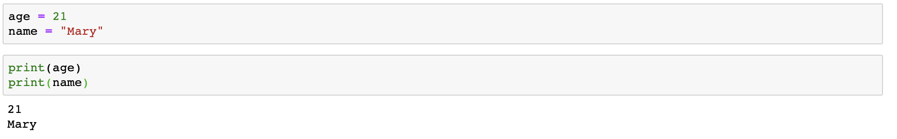
Create integer & string variables

Slide 15
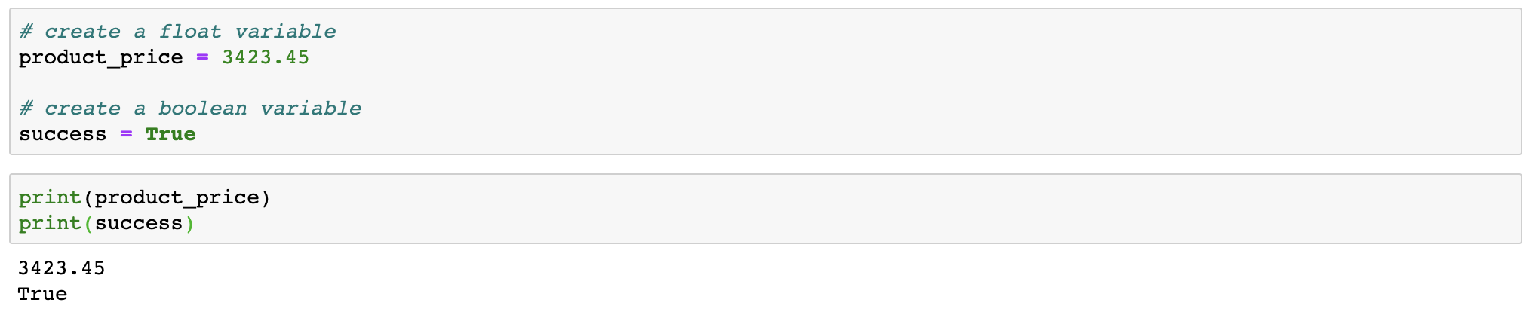
Create float & boolean variables

Slide 16
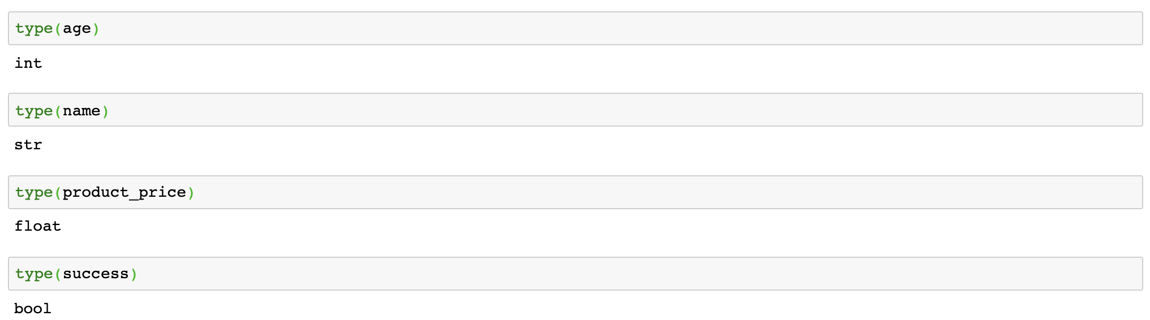
Checking data types with type() function

Slide 17
Data type conversion
Python allows to convert one data type to another
Implicit Conversion: Conversion done by Python interpreter with programmer’s intervention
Explicit Conversion: Conversion that is user-defined that forces an expression to be of specific data type
Type Conversion
Implicit Conversion
Explicit Conversion
Arithmetic Operation
Casting Operation

Slide 18
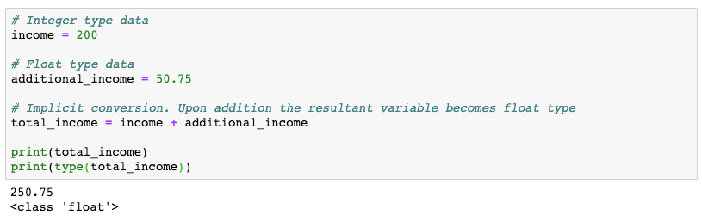
Implicit conversion

Slide 19

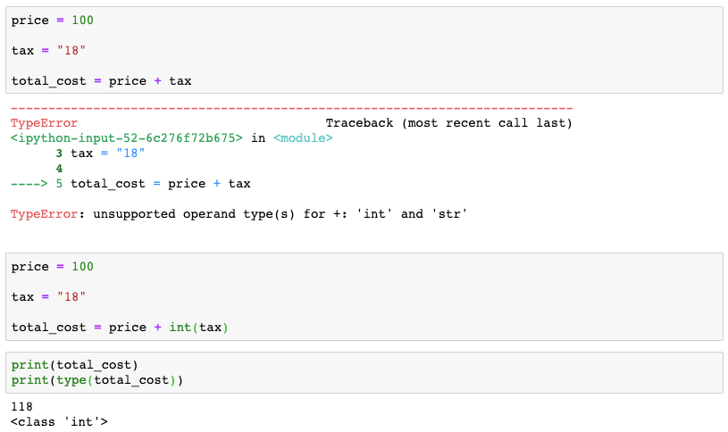
Explicit conversion is required when you have mixed data types.
Numeric Data type
String Data type

Slide 20
Explicit conversion
String Data type. Needs to be converted to integer type before adding to another numeric variable
Explicit type conversion of string to integer type

Slide 21
Type casting
Type Casting
int()
float()
str()
bool()

Slide 22
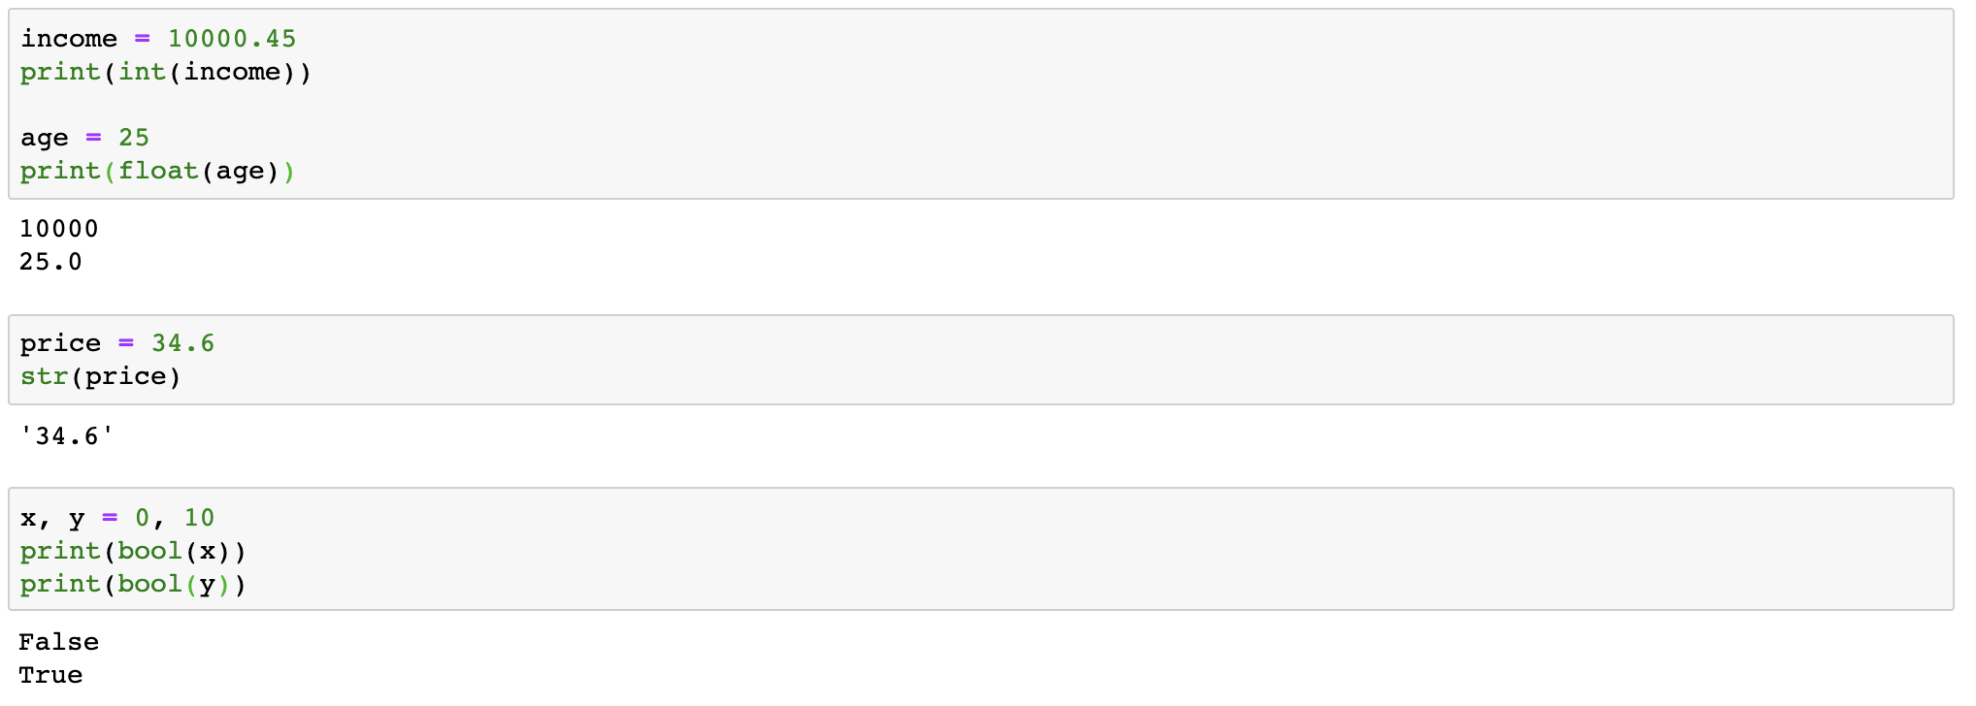
Type casting

Slide 23
Functions in Python

Slide 24
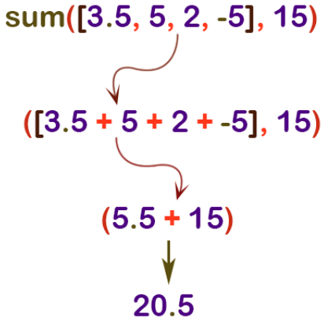
What is a function?
A function is a block of code that runs when called
A function has a name. You call the function by its name
A function can take input(s), known as input parameters
A function can return data as a result
Name of the function, sum()
Input parameters
Return value of the function

Slide 25
The print() Function

Slide 26
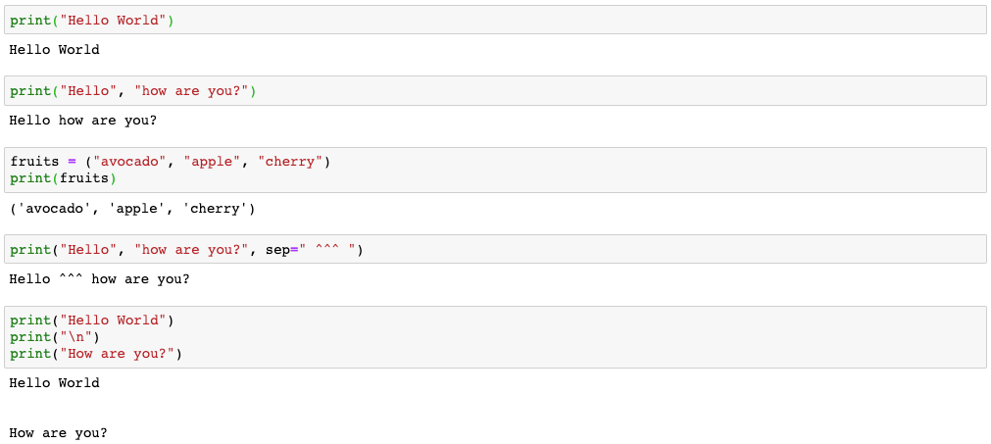
The print() in python
Words or sentences separated by a comma within a print() function get concatenated when printed.

Slide 27
The print() in python
The sep is an optional parameter. When output is printed, each word is separated by ^^^ characters
print(‘\n’) gives a new blank line
The backslash “\” is known as escape character. It is used in representing certain whitespaces.
For example ‘\t’ is a tab and ‘\n’ is a new line.

Slide 28
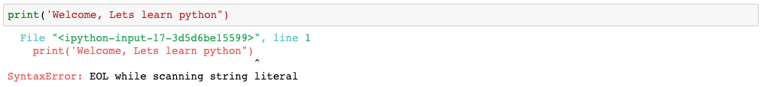
Invalid use of opening and closing quotes

Slide 29
Print with concatenation

Slide 30
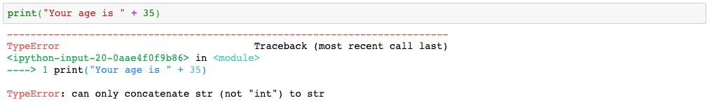
You cannot concatenate string & number
That’s wrong because adding numbers to strings doesn’t make any sense. You need to explicitly convert the number to string first, in order to join them together.

Slide 31
Concatenating with type casting
Explicit conversion of a number to string with str() function.
We learn more such type conversions in our upcoming sessions

Slide 32
Python Operators

Slide 33
Python operators
Python Operators
Arithmetic Operators
Relational Operators
Logical Operators
Special Operators
Bitwise Operators
Assignment Operators

Slide 34
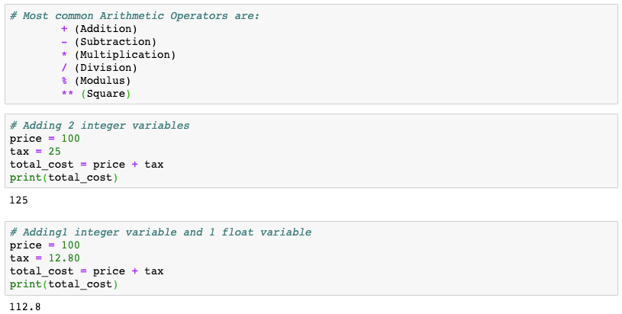
Arithmetic operators: Addition

Slide 35
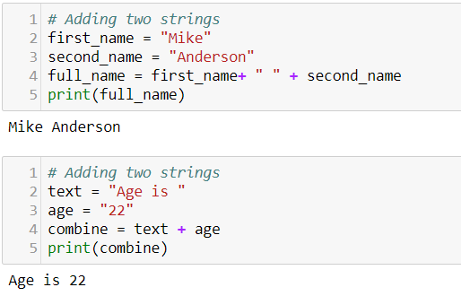
Arithmetic operators: Addition
Note that 22 is a string here because it has been put within the quotes.
Here two strings are getting concatenated.

Slide 36
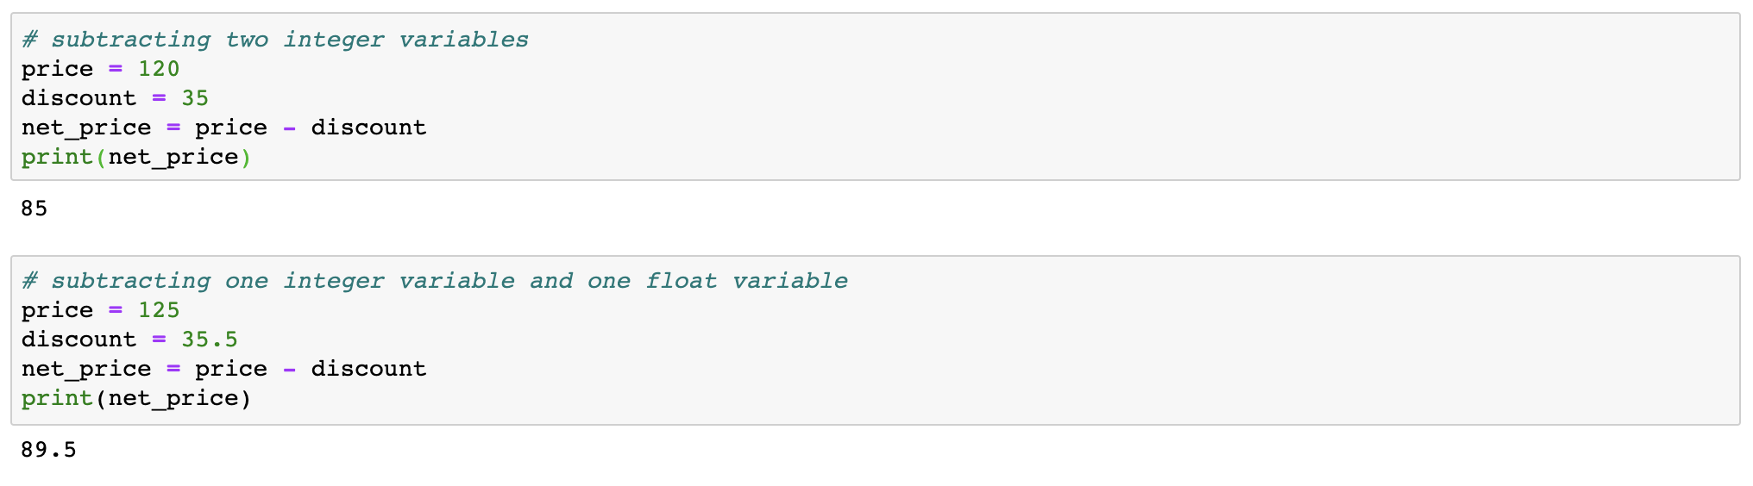
Arithmetic operators: Subtraction

Slide 37
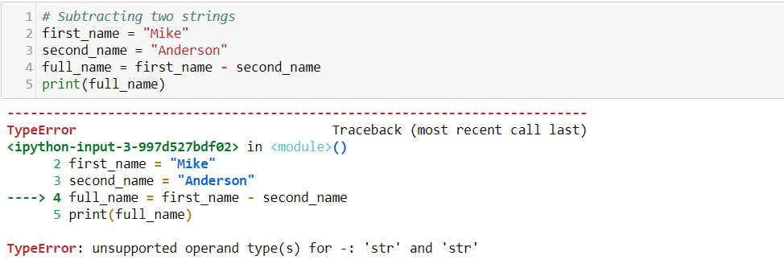
Arithmetic operators: Subtraction
When two strings are added, the operator basically concatenates the two strings. Subtracting two strings does not make any sense.

Slide 38
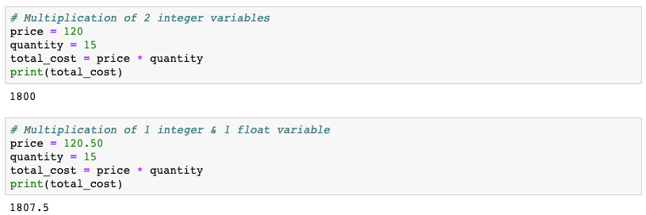
Arithmetic operators: Multiplication

Slide 39
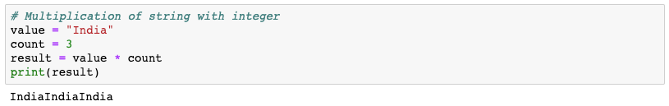
Arithmetic operators: Multiplication

Slide 40
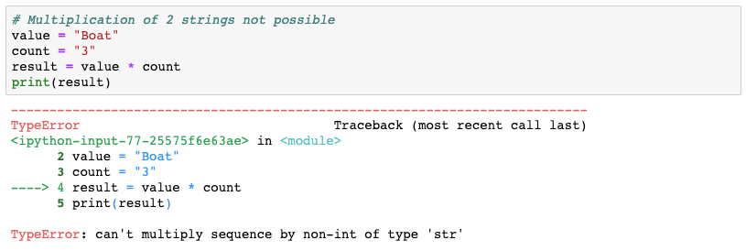
Arithmetic operators: Multiplication

Slide 41
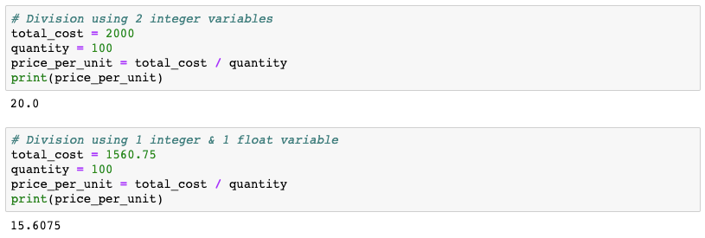
Arithmetic operators: Division

Slide 42
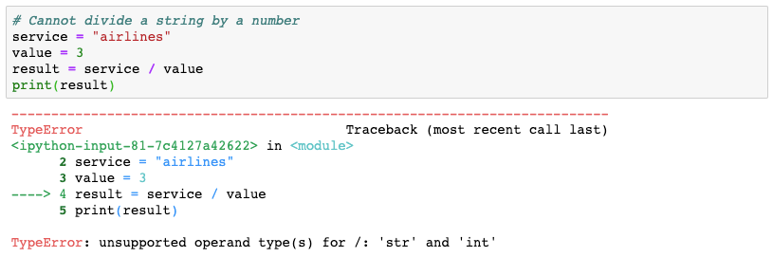
Arithmetic operators: Division

Slide 43
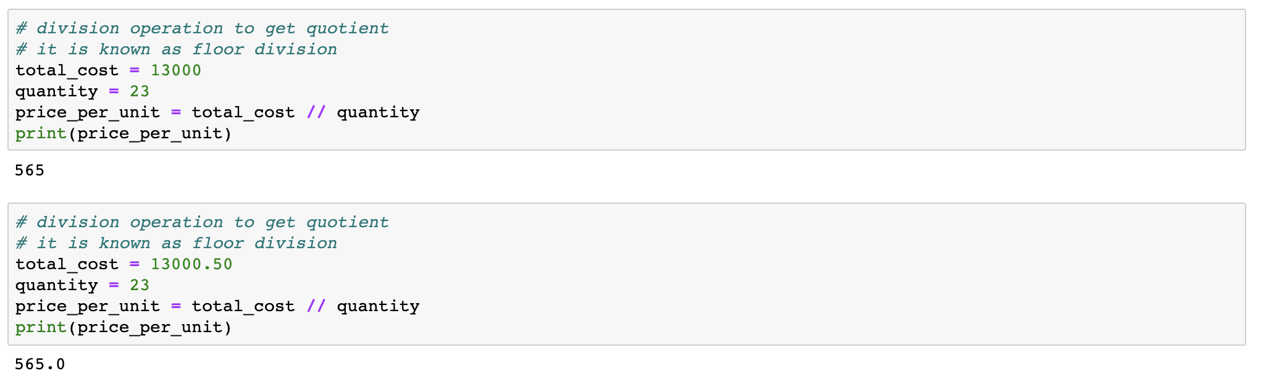
Arithmetic operators: Get quotient

Slide 44
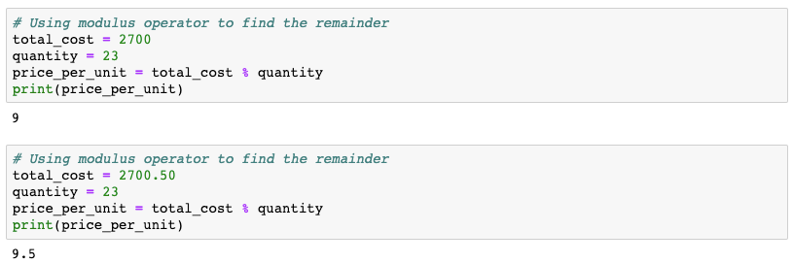
Arithmetic operators: Get remainder

Slide 45
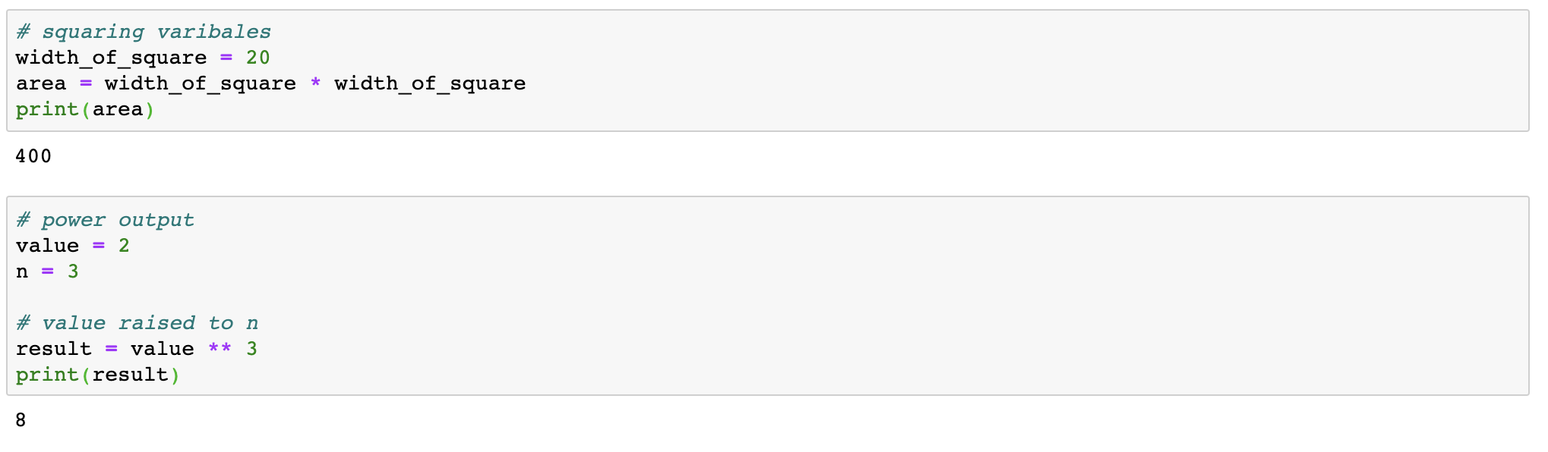
Arithmetic operators: Get square & power output

Slide 46
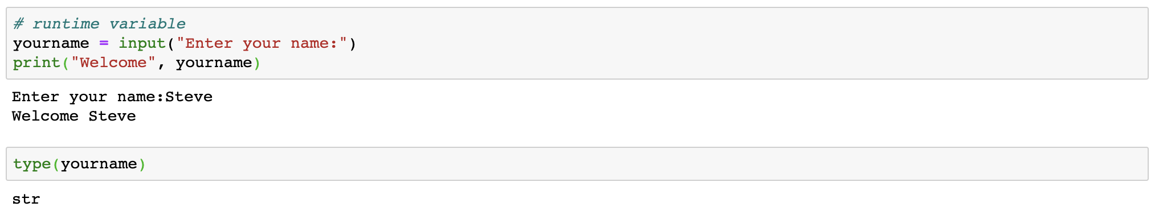
Runtime variable

Slide 47
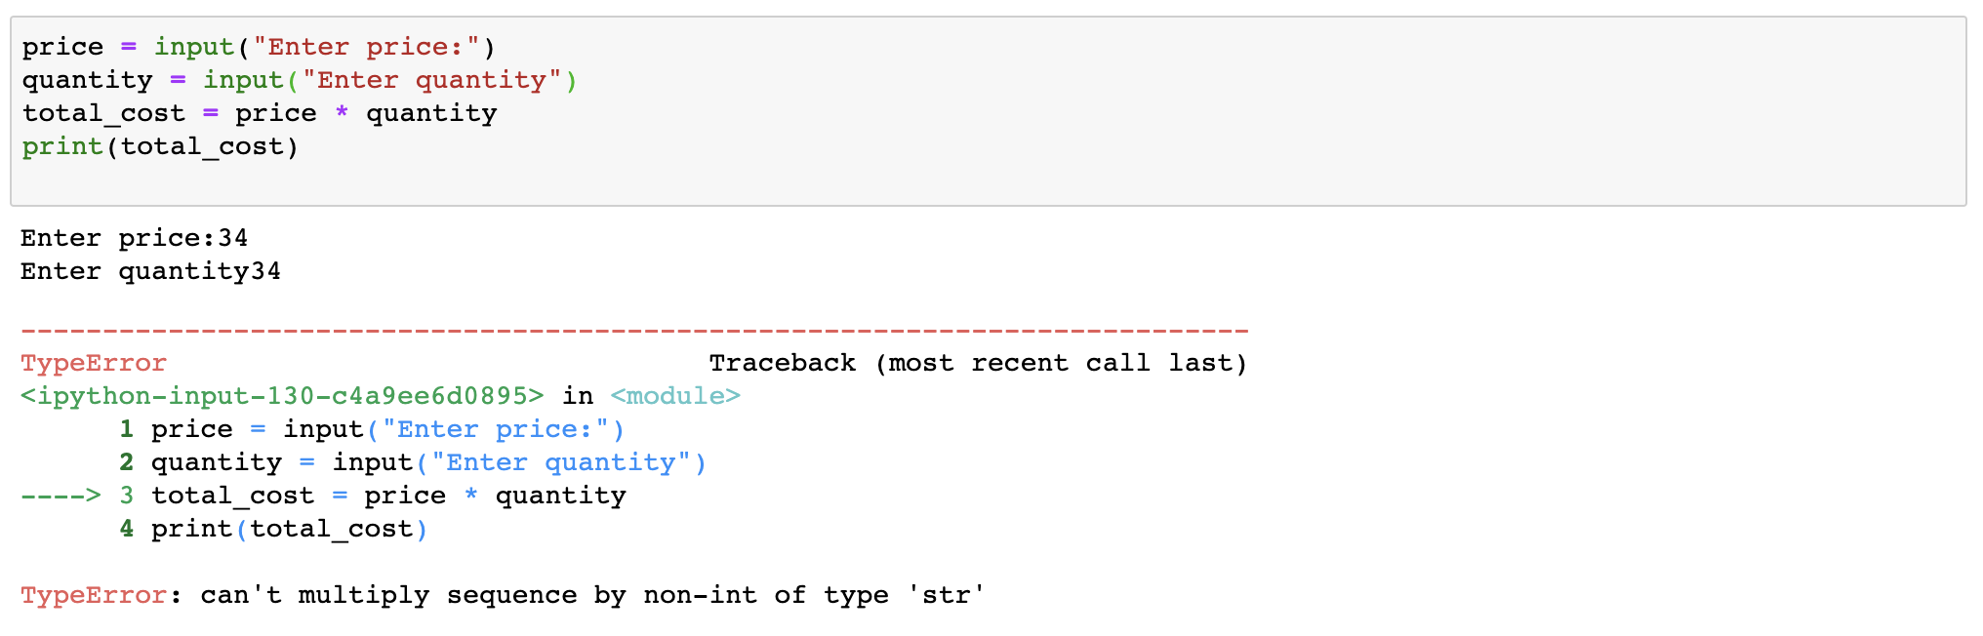
Runtime variable
The default return type of a runtime variable is string.

Slide 48
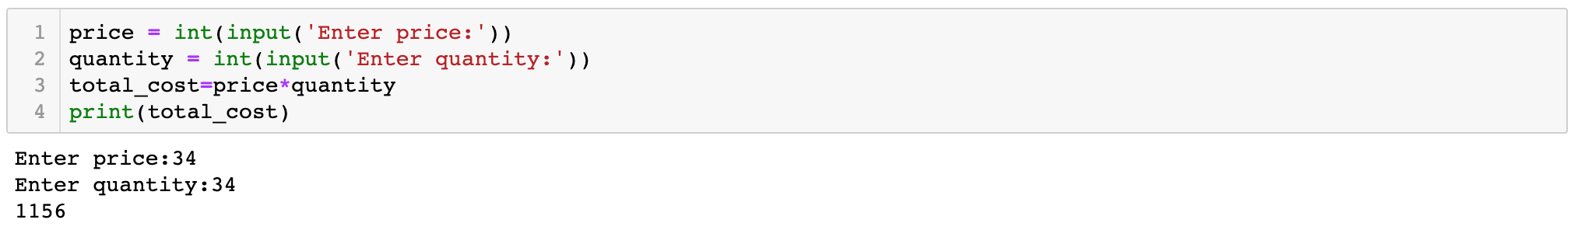
Runtime variable
The default return type of a runtime variable is string. So in order to use the entered value for computation we convert the values to integer.

Slide 49
Relational operators
Relational operators are used to compare 2 values and take certain decisions based on the outcome (outcome is is a boolean value)
<
<=
>
>=
==
!=
is less than
is less than & equal to
is greater than
is greater than & equal to
is equal to
is not equal to

Slide 50
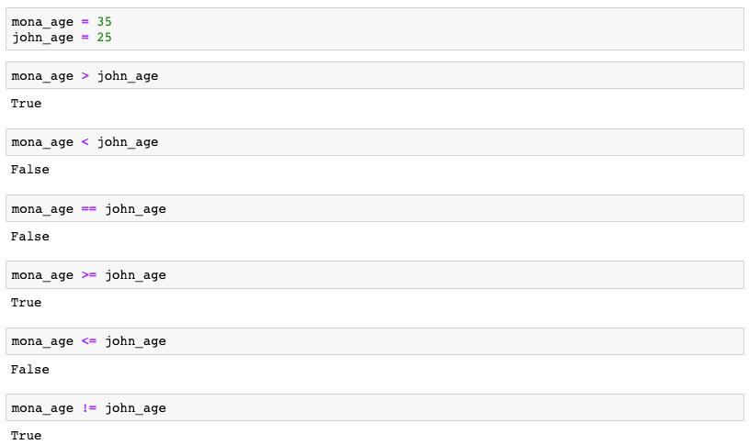
Relational operators

Slide 51
Logical operators
Logical operators in Python are used for conditional statements are either True or False
AND
OR
NOT
Returns True if both the operands are True
Returns True if either of the operands are True
Returns True if the operand is False

Slide 52
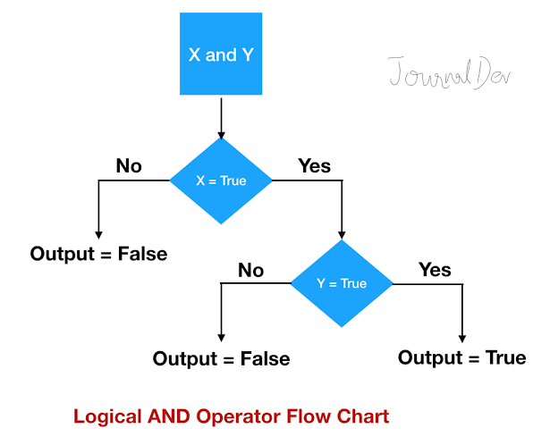
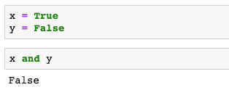
AND operator

Slide 53
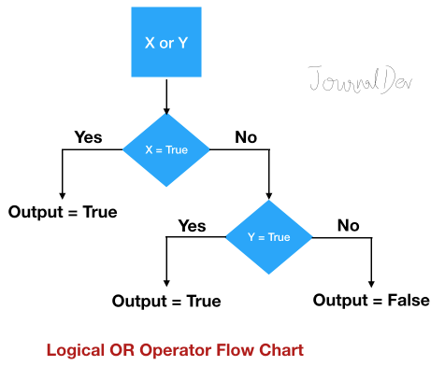
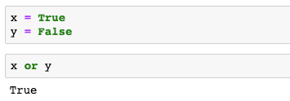
OR operator

Slide 54
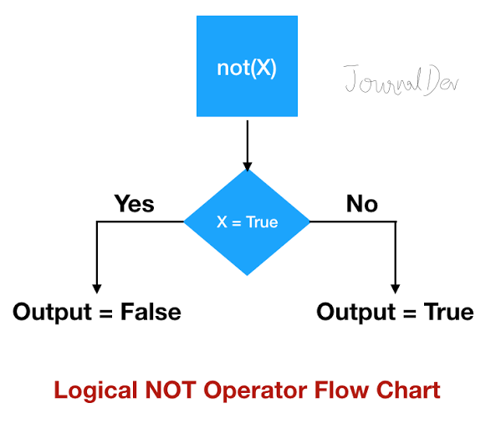

NOT operator

Slide 55
Membership operators
Membership operators tests whether a value is a member of a sequence. The sequence may be a list, a string, a tuple, or a dictionary.
in
The ‘in’ operator is used to check if a value exists in any sequence object or not. For example, if 2 exists in a list, say [4, 5, 7, 2]. This evaluates to True if it finds a value in the specified sequence object. Otherwise it returns a False.

Slide 56
Membership operators
not in
A ‘not in’ works in an opposite way to an ‘in’ operator. A ‘not in’ evaluates to True if a value is not found in the specified sequence object. Else it returns a False.

Slide 57
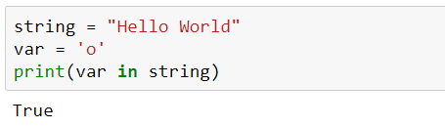
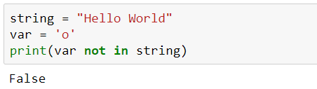
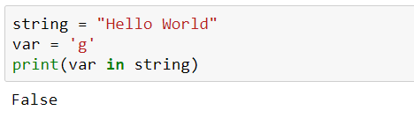
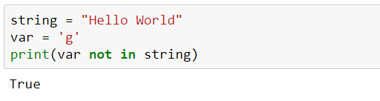
Membership operators
Example:
in operator:
not in operator:

Slide 58
Some bitwise operators
Python Bitwise Operators take one to two operands, and operates on it/them bit by bit, instead of whole
&
(Bitwise and)
|
(Bitwise or)
The binary and (&) takes two values and performs an AND-ing on each pair of bits.
Compared to &, this one returns 1 even if one of the two corresponding bits from the two operands is 1.

Slide 59
The truth tables
& (Bitwise and)
| (Bitwise or)
Value | Value | Value & Value
True | True | True
True | False | False
False | True | False
False | False | False
Value | Value | Value | Value
True | True | True
True | False | True
False | True | True
False | False | False

Slide 60
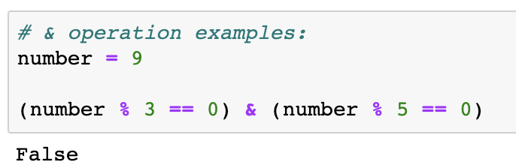
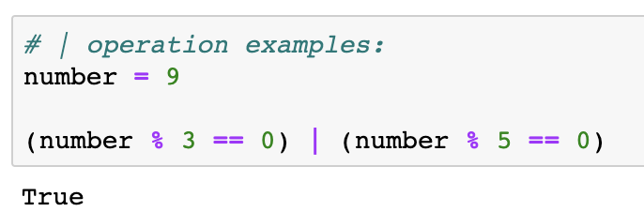
Some bitwise operators
Example:
& operator:
| operator:
(9 % 3 == 0) & (9 % 5 == 0)
Implies True & False
This results in Fasle.
(9 % 3 == 0) | (9 % 5 == 0)
Implies True | False
This results in True.

Slide 61
More assignment operators
The assignment operators are used to store data into a variable.
a += b is same as a = a + b
a *= b is same as a = a * b
a /= b is same as a = a / b
a %= b is same as a = a % b
a **= b is same as a = a ** b
a //= b is same as a = a // b

Slide 62
Data slicing
The basic syntax for a slice is square brackets with colons and integers inside "[0:1:2]".
myStr[start : stop : step]
myStr[ : stop] # By using one colon and leaving the first argument blank we automatically start at index 0, stepping by 1
myStr[start : ] # By using one colon and leaving the last argument blank we automatically go to the end, stepping by 1
myStr[ : : step] # by using two colons and leaving the first two arguments blank we start at index 0, go to the end and step by 1

Slide 63
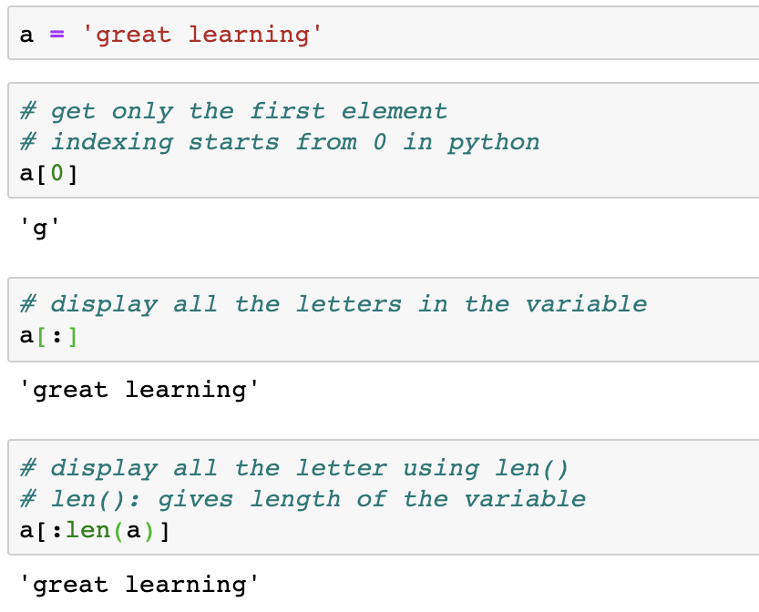
Data slicing
‘:’ is used to specify range of the sequence to be sliced

Slide 64
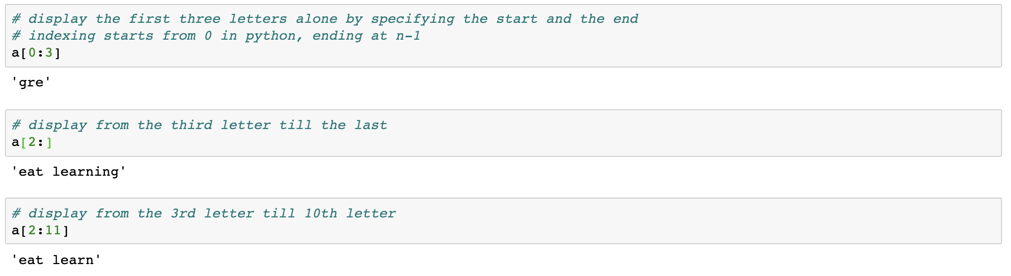
Data slicing

Slide 65
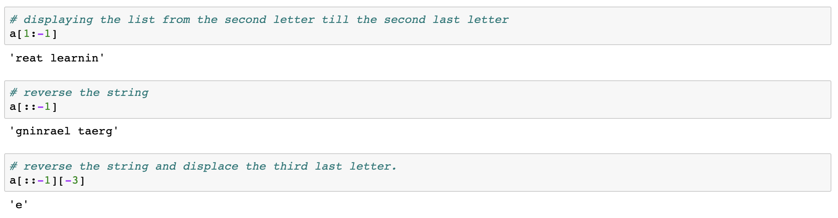
Data slicing

Slide 66
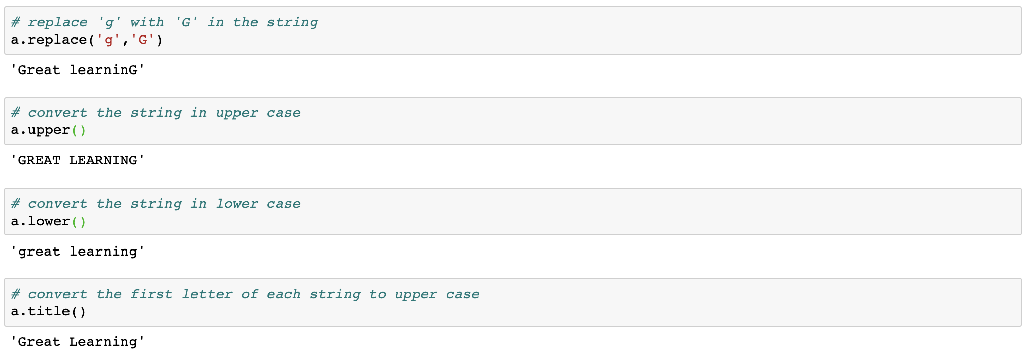
String Handling

Slide 67
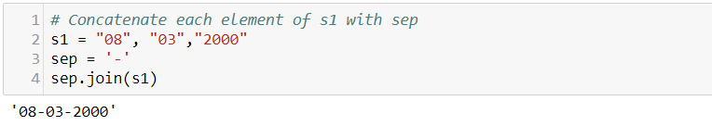
String Handling
Returns a concatenated string where each character of s1 is separated with sep string which is ‘-’

Slide 68
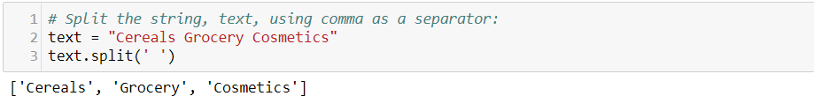
String Handling
Returns a list containing elements as strings separated by the space character

Slide 69

String Handling
Returns a copy of the string with both leading and trailing characters removed (based on the string argument passed)

Slide 70
Python Flow Control

Slide 71
Python Flow Control
Any program has a flow. The flow is the order in which the program’s code executes. The control flow of a Python program is controlled by:
1. Conditional Statements
2. Loops
3. Function Calls
We cover the basics of conditional statements and loops in today’s session

Slide 72
The if-statement
Sometimes we want to execute a code only if a certain condition is true.
The if statement is used in Python for decision making. An "if statement" is written by using the if keyword.
Syntax:
if test expression:
statement(s)

Slide 73


The if-statement

Slide 74
The if-else statement
The ‘if..else’ statement evaluates a test expression and will execute the code that is part of the ‘if’ expression if the test expression True.
If the test expression is False, the code that is part of the ‘else’ expression is executed. Note the indentation that is used to separate the ‘if’ and ‘else’ blocks.
Syntax:
if test expression:
Body of if
else:
Body of else

Slide 75


The if-else statement

Slide 76
The while Loop
Loops are used to repeat the execution of a specific block of code.
The ‘while loop’ in Python is used to iterate over a block of code as long as the test expression holds true.
We generally use this loop when the number of times to iterate is not known to us beforehand.
Syntax:
while test_expression:
Body of while

Slide 77


The while Loop

Slide 78
The for Loop
The ‘for loop’ in Python is used to iterate over the items of a sequence object like list, tuple, string and other iterable objects.
The iteration continues until we reach the last item in the sequence object. Note the indentation that is used in a ‘for loop’ to separate the rest of the code from the ‘for loop’ syntax
Syntax:
for i in sequence:
Body of for

Slide 79


The for Loop

Slide 80
Pseudocode

Slide 81
What is Pseudocode?
Pseudocode is a step-by-step written outline of your code that you can gradually transcribe into programming language

Slide 82

Example: Pseudocode
Find the sum of 5 numbers:
Set sum=0, count=0
Enter the number
Add number to sum and store it back to sum
Increment count by 1
If count < 5, go to step 2 else print total

Slide 83

Write pseudocode to calculate sum & average of 10 numbers that you input

Slide 84


There exists a word “Pythonic”? What does it mean?
There are many ways to accomplish the same task in Python, but there is usually one preferred way to do it. This preferred way is called "pythonic."
Read The Hitchhiker’s Guide to Python (https://docs.python-guide.org/writing/style/).

Slide 85
Thank You

